Slide 1

DIP Project
ASL DETECTION

Slide 2

Meet
THE TEAM
Abdullah Shakeel
Hassaan Tahir
Abdullah Shamshad
Muhammad Taosiq

Slide 3

INTRODUCTION
The problem is to develop a sign language recognition model in computer vision that can accurately detect and recognize sign language gestures in a Picture or video and classify them.
To develop a deep learning model that can perform sign language recognition in real-time video input or pre-recorded video data.

Slide 4
First Approach
01
Data Collection
02
Data Preprocessing
03
Model Selection
04
Model Training
05
Model Testing

Slide 5

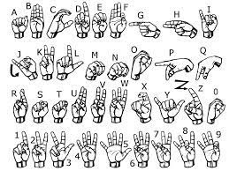
DATA COLLECTION
Challenge: Collect a large and diverse dataset of sign language gestures in varying lighting conditions and camera angles. The dataset should be balanced and represent different sign languages
Solution: We used an online dataset of 3000 images per label .

Slide 6

Data Preprocessing
Image preprocessing was done:
rescaling
horizontal flip
rotation
zoom

Slide 7
We selected a a powerful pre-trained convolutional neural network (CNN) called Xception.
To adapt Xception for ASL language detection, I implemented custom layers on top of the pre-trained Xception model. These additional layers include convolutional layers and dense layers. The convolutional layers help in extracting intricate features from the input ASL images, capturing nuanced patterns crucial for recognizing various hand gestures and signs. Meanwhile, the dense layers aid in learning and mapping these extracted features to predict the corresponding ASL language or signs.
Model Selection

Slide 8
Model Training and Testing
- Result: Test accuracy of: 78%
- Shortcomings: not realtime. Couldn’t detect hand location. Mostly worked with white background

Slide 9
SECOND APPROACH

Slide 10
We created our own dataset of 3900 images of the 26 alphabets of English language.
Each alphabet had 150 images of
50 with white background
50 with brown background
50 with green background
We used Roboflow to label our images.
Data Collection

Slide 11
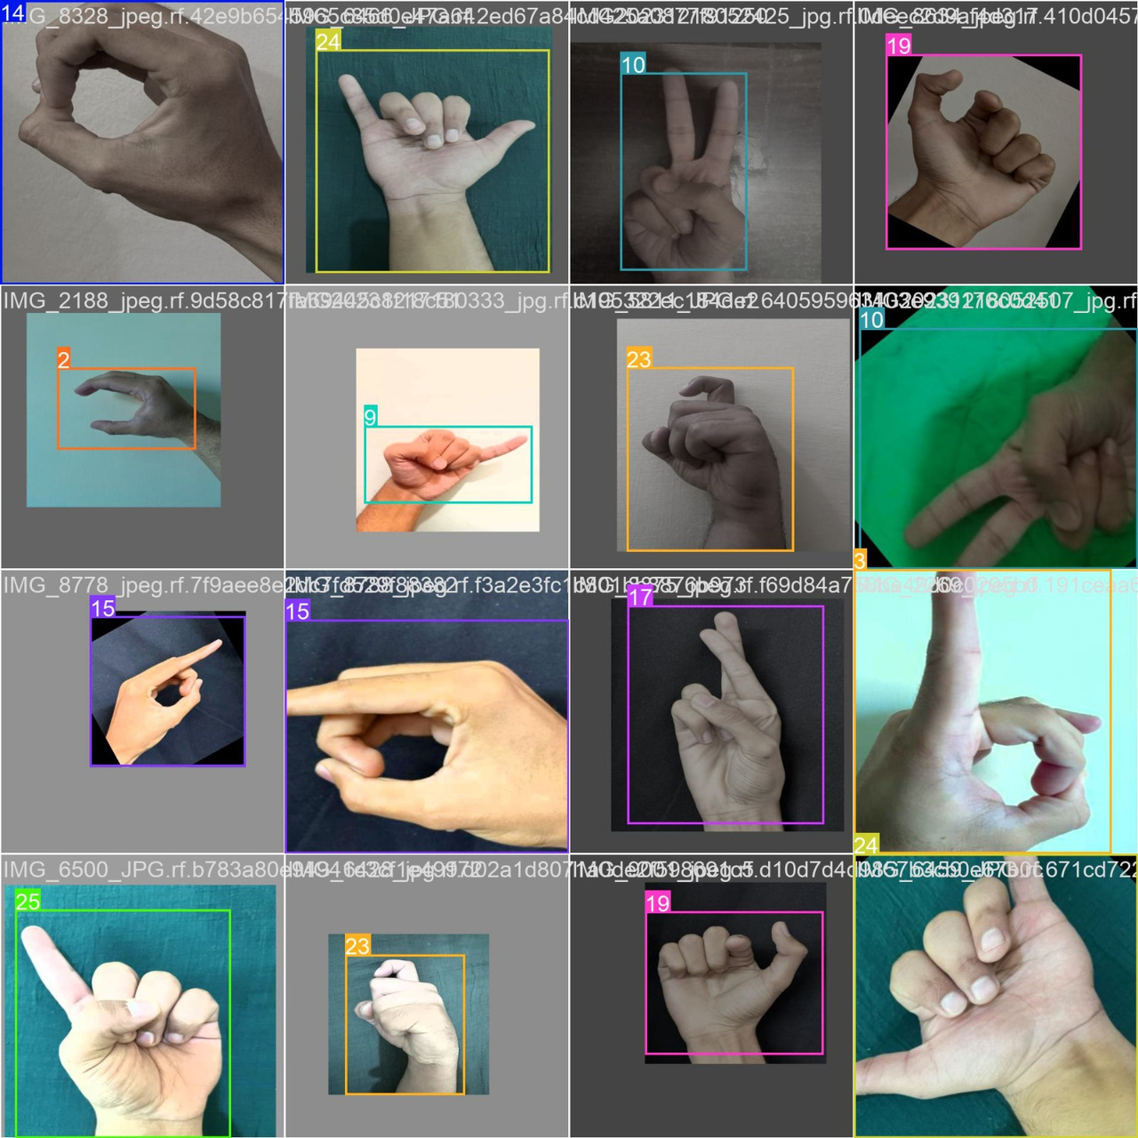

Slide 12
Data Preprocessing
In the data preprocessing phase, we standardized the images by resizing them to a uniform size. This step ensures consistency in the dataset, allowing the model to process all images at the same dimensions.

Slide 13
Data Augmentation
During the data augmentation process, we implemented techniques like horizontal flip and rotation within a range of 45 degrees and -45 degrees. These augmentations introduce variations in the dataset by flipping images horizontally and rotating them within specified angles. This augmentation strategy expands the diversity of the dataset.

Slide 14
Model Testing and Training
We leveraged the YOLOv8s architecture, a state-of-the-art object detection model pre-trained on a large dataset.
For training, we split the dataset into training and validation sets.
We evaluated the model's performance using a separate test set that the model hadn't seen before.

Slide 15
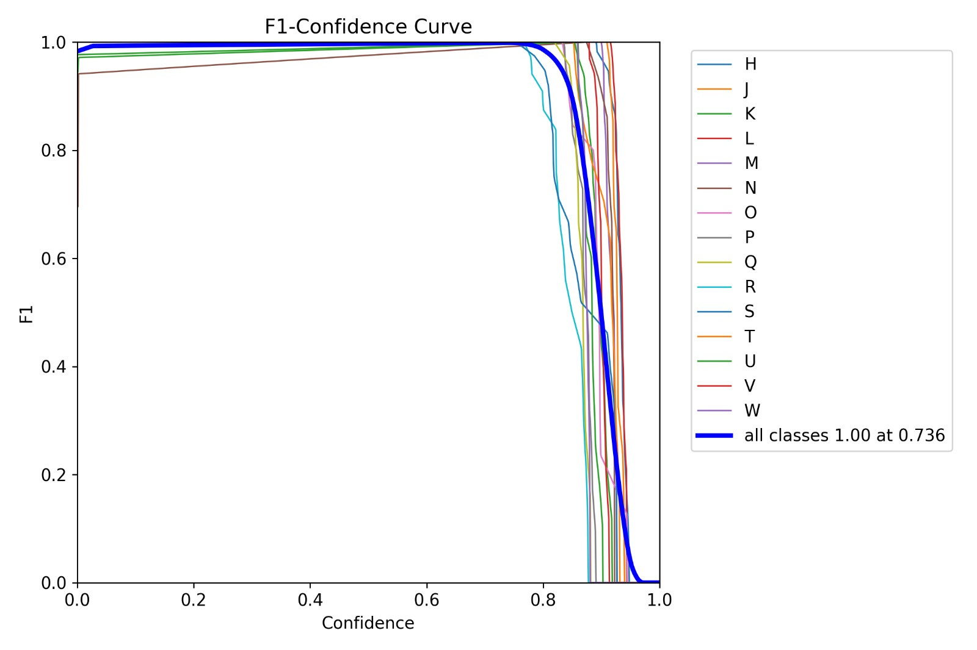

Slide 16
Result
Our system now possesses the capability to detect the position of hands within the data accurately. Moreover, this model is optimized for real-time video analysis and can seamlessly process both live video feeds and simpler pre-recorded videos.

Slide 17
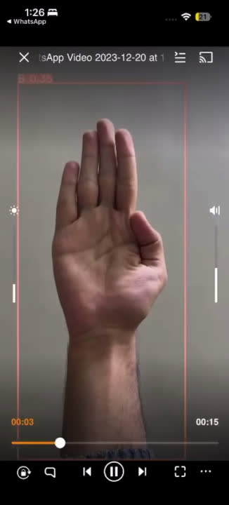

Slide 18
THANK YOU

